Slide 1
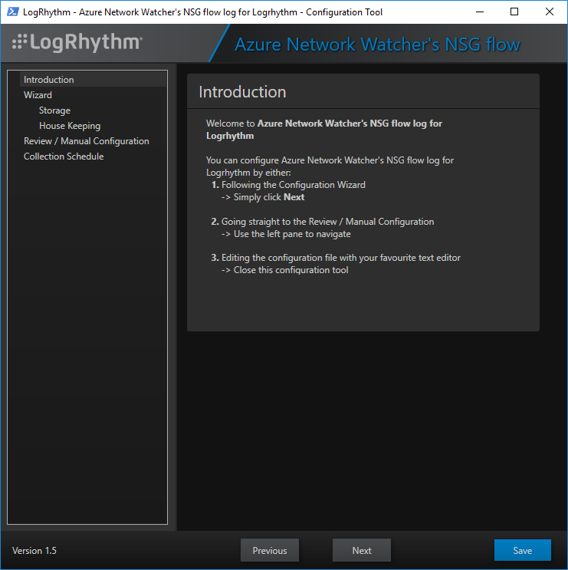





Open-Collector Helper
Open-Collector Helper
Welcome & Help
Login
Status
Installation
Pipelines
Welcome!
The Open-Collector Helper is a public contribution, and as such
it is NOT supported by LogRhythm.
If you require help, use the Community for your questions.
https://community.logrhythm.com/.......
I Agree
Exit

Slide 2




Open-Collector Helper
Open-Collector Helper
Welcome & Help
Login
Status
Installation
Pipelines
Login
Open-Collector Host:
Remember this host
p
q
X
Login:
Remember me on this host
X
Password:
Remember my password on this host
Connect
Options
v

Slide 3

Open-Collector Helper
Open-Collector Helper
Welcome & Help
Login
Status
Installation
Pipelines
Login
Open-Collector Host:
Remember this host
p
q
X
Login:
Remember me on this host
X
Password:
Remember my password on this host
Connect
Options
Options
v
SSH port:
22
Proxy host:
Proxy port:
Proxy type:
p
q

Slide 4



Open-Collector Helper
Open-Collector Helper
Welcome & Help
Login
Status
Installation
Pipelines
Status
Docker:
None
Installed
Running
Open-Collector:
None
Installed
Running
Internet Connectivity:
None
Connected
Pipelines:
Status
Name

Slide 5
Open-Collector Helper
Open-Collector Helper
Welcome & Help
Login
Status
Installation
Pipelines
Installation
Default Full Install
Advanced
v
Options
v

Slide 6
Open-Collector Helper
Open-Collector Helper
Welcome & Help
Login
Status
Installation
Pipelines
Installation
Default Full Install
Advanced
v
OCHelper script (Bridgehead for this tool):
Status:
Check
Deploy
Operating System:
Version:
Check version
Tools:
Status:
Install LRCTL
Install LRJQ
Install OCPIPELINE
Docker:
Status:
Check
Install
Upgrade
Open-Collector:
Status:
Check
Install
Upgrade
Restart
Start
Stop
Open-Collector Configuration:
Status:
Export
Import

Slide 7
Open-Collector Helper
Open-Collector Helper
Welcome & Help
Login
Status
Installation
Pipelines
Installation
Default Full Install
Advanced
v
Options
v
Docker:
Installation extra & custom parameters:
Upgrade extra & custom parameters:
Open-Collector:
Installation, extra & custom parameters:
Upgrade, extra & custom parameters:
Restart, extra & custom parameters:
Start, extra & custom parameters:
Stop, extra & custom parameters:
Tools:
Extra repositories:

Slide 8
Open-Collector Helper
Open-Collector Helper
Welcome & Help
Login
Status
Installation
Pipelines
Pipelines
Installed pipelines:
Status
Name
Enabled
Disabled
Refresh
Auto-restart the Open-Collector
Pipelines projects:
Name
New
Install
Delete
Pipeline editor
v
Filter:
Save
Test
Re-load
Transform:
Save
Test
Re-load
Log sample:
Log
Match
Transform output
Load from file
Export to file

